Slide 1

Noisy Datasets and Their Effect in Deep Neural Networks
By: Carlos Gross-Martinez

Slide 2
Introduction
AI continues to be at the forefront of the vast majority of topics covered in the technology field. In our modern society, companies understand that in order to compete and succeed in such a crowded and demanding market, the implementation of AI technology is not only necessary but indispensable in order to enhance their functions and operations. One of the biggest technologies being developed in the AI industry are related with deep neural networks.
Although deep neural networks continue to evolve and make our lives easier, the training mechanisms used in order to create and build these models continue to face their fare share of challenges as well. One of such big challenges is found in the ability to obtain clean and reliable datasets to build and train a deep neural network.

Slide 3
Neuron Basics in
Deep Neural Networks

Slide 4
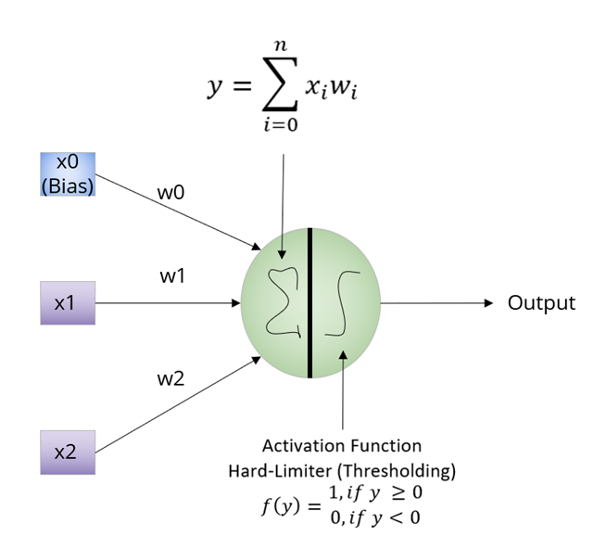
Neuron Basics in Deep Neural Networks
In order to understand the overall technique of deep neural networks, it is essential to have a notion in the strategy behind its most fundamental concept which is the neuron. The idea of Deep Learning is born from the implementation of various interconnected neurons in a network to build a deep neural network model with the ability to perform certain tasks.

Slide 5
Neuron Basics in Deep Neural Networks Cont.
The picture in the previous slide, shows a single neuron classification strategy once it has been trained. On the left, the picture shows the parameters of the neurons which consists on the features of the input to the neuron alongside the bias. Moreover, the picture shows that each feature in the neuron contains an individual weight. During training and validation, each weight for each parameter is altered constantly to reduce error and obtain the greatest probability of proper classification of the data sample.

Slide 6
Neuron Basics in Deep Neural Networks Cont.
Once the model has been trained and validated, the classification strategy is very simple consisting of computing the summation of the products of all the weights times their respective parameters. With the results from the summation, an activation function is executed in the results the prior step to output the final prediction or classification of the model

Slide 7
Deep Neural Network Basics

Slide 8
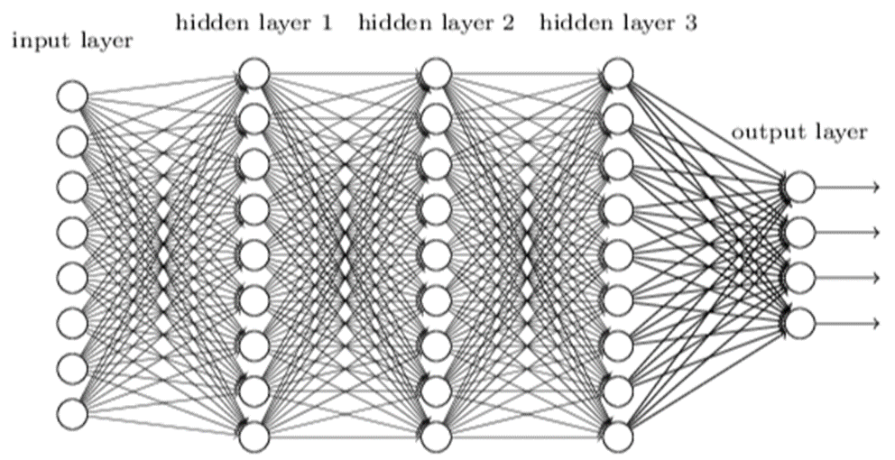
Deep Neural Network Basics
A deep neural network is comprised by stacking neurons on top of each other. Each neuron in the stack has a specific purpose and its parameter can be individually tuned to perform the overall assignment. A deep neural network is developed when layers of stacked neurons are group and connected together in order to conduct a specific job such as classifying an object to a specific class.

Slide 9
Deep Neural Network Basics Cont.
In comparing a deep neural network above with other models, it is essential to note that deep neural networks can have even more or less layers and more or less stacked neurons per layer in its design depending on the purpose of the model.
Additionally, it is essential to note that other deep neural networks designs can have its own independent number of neurons in each layer and they do not have to be equal in each layer as shown above.

Slide 10
Datasets and Deep Neural Networks

Slide 11
Datasets and Deep Neural Networks
In order for a deep neural network to conduct the same classification as any person, it needs to be trained with a dataset to help them learn and distinguish the differences between the classes or labels in the dataset. In the same manner as a human, a deep neural network model will receive the attributes or characteristics of a sample in a dataset as its input to the neurons and it will adjust the weights of the model in order to increase the probabilities of a proper classification of the data sample in each iteration.

Slide 12
Datasets and Deep Neural Networks Cont.
The deep neural network will have to iterate as many times as necessary in order to fine tune its weights in order to make the proper classifications of the dataset. In order to accomplish this feat, the dataset needs to be divided into two separate subsets of the main dataset. One subset will contain all the samples related to one specific class or label, while the second subset will contain the remaining samples of the second class. By conducting this segmentation for each class, we are able to feed the samples to the deep neural network in order to train it to distinguish between the two separate classes or labels.

Slide 13
Noisy Datasets and Deep Neural Networks

Slide 14
Noisy Datasets and Deep Neural Networks
The expansion of the internet has allowed for the gathering of data to increase monumentally in the past two decades. Today, data is being gathered through cell phones, social media, research, and many other forms to build massive knowledge bases which allows for information to be available to the masses for mining and exploitation purposes. Nevertheless, these massive amounts of information are very hard to categorize and maintain and they continue to grow with the passage of each day.

Slide 15
Noisy Datasets and Deep Neural Networks Cont.
the lack of proper classification of the information has allowed for the data to be misleading in various senses causing big problems when using the data to train deep neural network models.
This misleading information or misrepresentation in the label of a sample can be considered as noise in the dataset. In order words, noise in a dataset can be defined as the improper labeling of samples in a dataset in regards to the proper label or classification of a sample

Slide 16
Techniques to Tackle Noisy Datasets and Deep Neural Networks

Slide 17
Techniques to Tackle Noisy datasets and Deep Neural Networks
In order to mitigate the problem with noisy datasets, the industry has come up with different approaches in order to address this problem. One of the most rudimentary solutions is to have a group of people to go through each sample in a dataset in order to ensure that the samples are categorized properly. Nevertheless, this approach is not the best way to confront the problem since if a dataset contains 1 million samples, then a lot of people will have to perform this tedious task in order to completely remove the noise of the dataset, and even then, factors like fatigue and human error can also have an impact in properly reducing all the noise from the classes in the dataset.

Slide 18
Techniques to Tackle Noisy datasets and Deep Neural Networks Cont.
Another approach proposed by Jinchi Huang et al, consist in implementing a novel technique call O2U. Which consist on building deep neural networks with the ability to learn with noisy samples and still build robust models. In their research, they argue that having noisy samples in a dataset causes a model to overfit the classifier. Hence, they would need to underfit the model in order to compensate for the overfitting in order to create a balance which will provide the highest level of performance of the model with the available data

Slide 19
Techniques to tackle Noisy datasets and Deep Neural Networks Cont.
Others researches in the industry such as Taghi et al, studies and researches the impact of noise in a dataset based on the model by implementing different techniques to select better features from the dataset to build more robust models even if noise is present in the dataset. Additionally, Taghi et al, also studies the impact of using different sampling techniques in noisy datasets in order to produce more robust deep neural networks classifiers that are able to learn with noisy data.
Another approach in the process is to use loss functions in the model which are capable of creating better classifiers even though noise is present in a dataset. Nonetheless, it remains a fact that no matter the technique or approach, noise is an issue which greatly decreases the performance of a classifier when compared to models which use a training dataset which is free of noise.

Slide 20
Conclusion
Although there exists a great number of clean datasets which allows for the proper training of a deep neural network model, the vast majority of the data available is mostly noisy and the resources to conduct the cleansing of the dataset is just not feasible. With this information in mind, it is essential develop models which can be trained with noisy datasets and still have the same level of performance as in models trained with clean datasets. Additionally, it is essential to understand that although there are techniques in the industry in order to build robust models with noisy datasets, these techniques are far from perfect and still require a lot of research in order to ensure that models can still be trained and performed as desired with mislabeled information

